Slide 1

GOVERNMENT ARTS AND SCEINCE COLLEGE PERUMBAKKAM
SUBMITTED FOR THE PARCIAL FULFILMENT
OF
BSc COMPUTER SCIENCE

Slide 2
Predicting Personal Loan APPROVAL Using Machine Learning

Slide 3
TEAM MEMBERS
A.AYESHA
A.SUDHA
K.VIJAYALAKSHMI
R.ABIRAMI
SHARMILA

Slide 4

Agenda
Introduction
Machine Learning
Screen Design
Output Result
Conclusion

Slide 5
INTRODUCTION
Personal loans are a popular financial product that many individuals use to fund a variety of expenses, such as home renovations, car purchases, or debt consolidation. However, one of the main risks associated with personal loans is the possibility of default, which can lead to financial loss for both the lender and the borrower. Therefore, it is crucial for lenders to accurately predict the likelihood of loan default in order to make informed lending decisions and mitigate risk.
Machine learning has emerged as a powerful tool for predicting loan default, using a variety of techniques to analyze data and identify patterns that are predictive of borrower behavior. By analyzing historical loan data and borrower characteristics, machine learning models can predict the probability of loan default with high accuracy. This can help lenders to make more informed decisions about loan approval, interest rates, and credit limits, ultimately improving their bottom line while minimizing risk.

Slide 6
Machine Learning
Data Collection: Describe the source of the data used in the project and provide an overview of the dataset.
Data Preprocessing: Explain the steps taken to prepare the data for machine learning, including data cleaning, feature engineering, and feature selection.
Exploratory Data Analysis: Present the findings of the exploratory data analysis, including visualizations and insights gained from the data.
Model Selection: Describe the various machine learning algorithms considered for the project and explain why a particular algorithm was chosen.
Model Training: Explain how the chosen machine learning algorithm was trained on the dataset.
Model Evaluation: Present the results of the model evaluation, including the metrics used to assess the performance of the model.
Hyperparameter Tuning: Describe the process of tuning the hyperparameters of the model to improve its performance.
Prediction: Provide examples of how the model can be used to predict whether an individual will default on their personal loan or not.

Slide 7
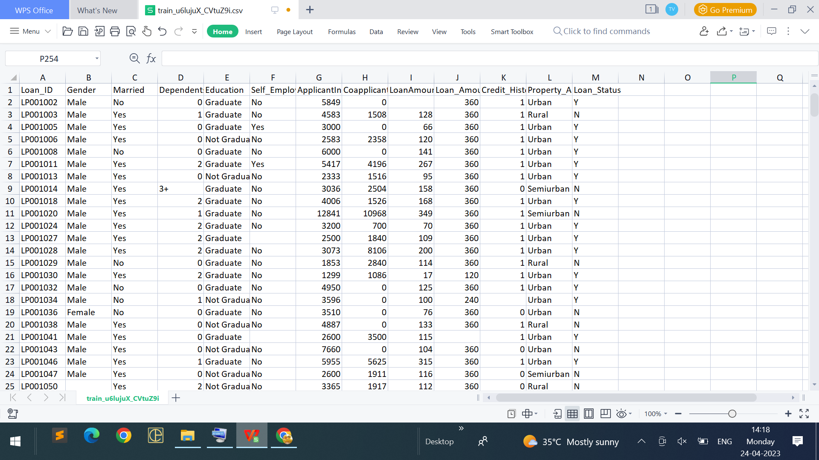
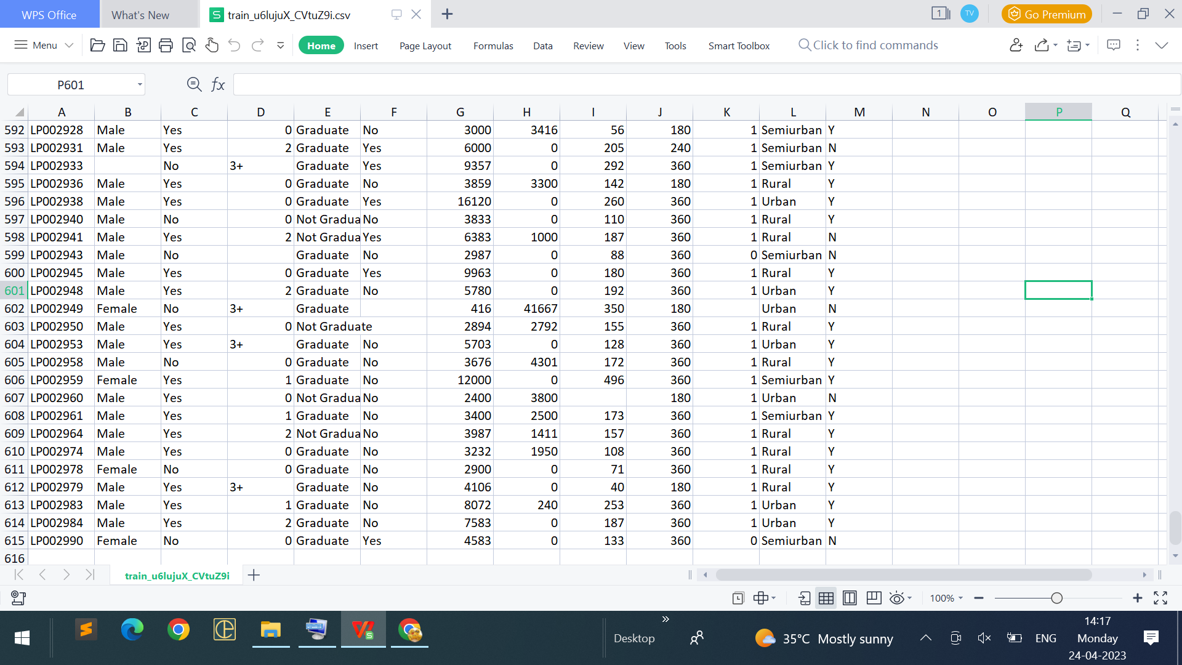
In this project we have used .csv data. This data is downloaded from kaggle.com. Please refer to the link given below to download the dataset. Link: https://www.kaggle.com/datasets/altruistdelhite04/loan-prediction-problem-dataset
Dataset:

Slide 8
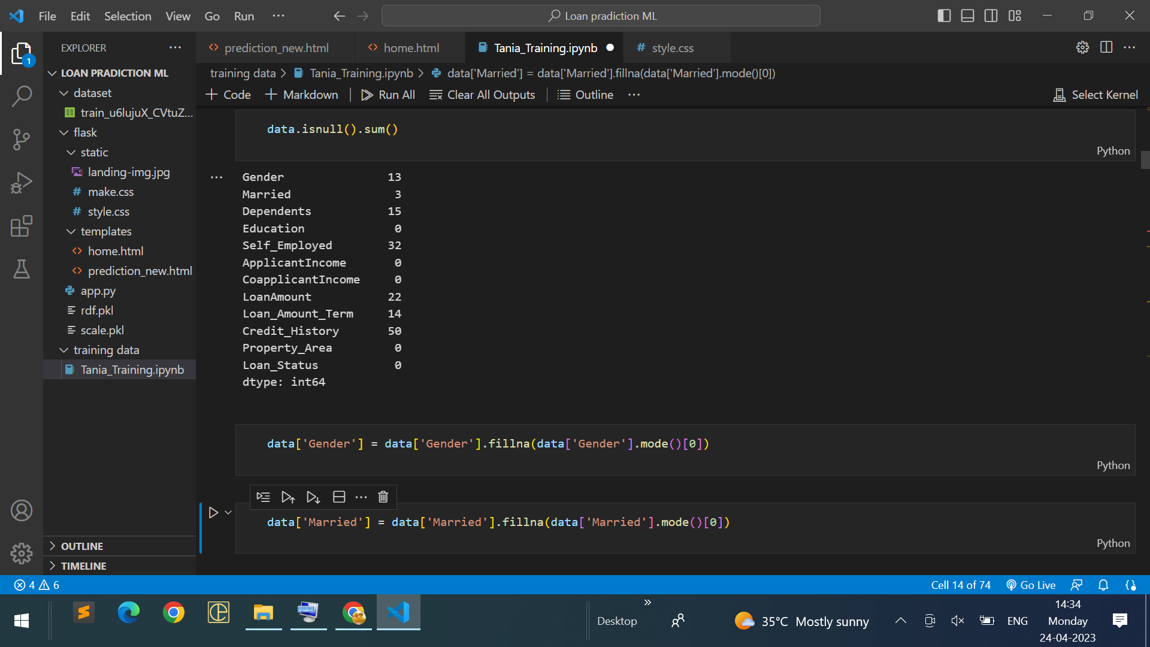
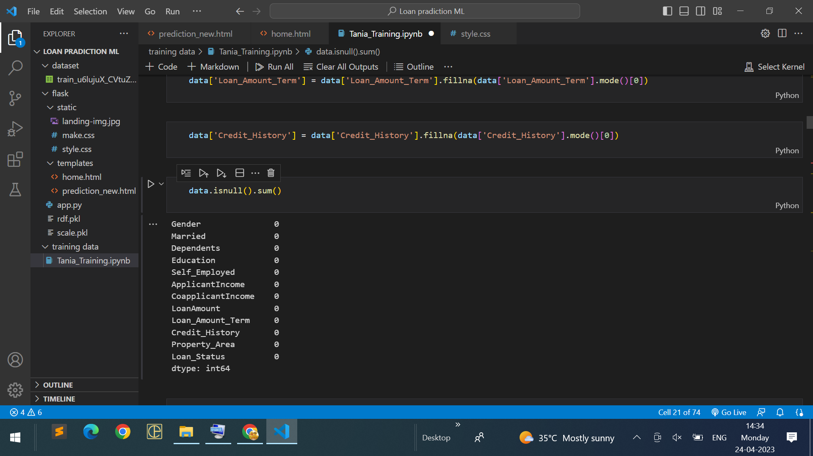
Data Preprocessing
As we have understood how the data is, let's pre-process the collected data.
The download data set is not suitable for training the machine learning model as it might have so much randomness so we need to clean the dataset properly in order to fetch good results. This activity includes the following steps.
Handling missing values
Handling categorical data
Handling Imbalance Data

Slide 9
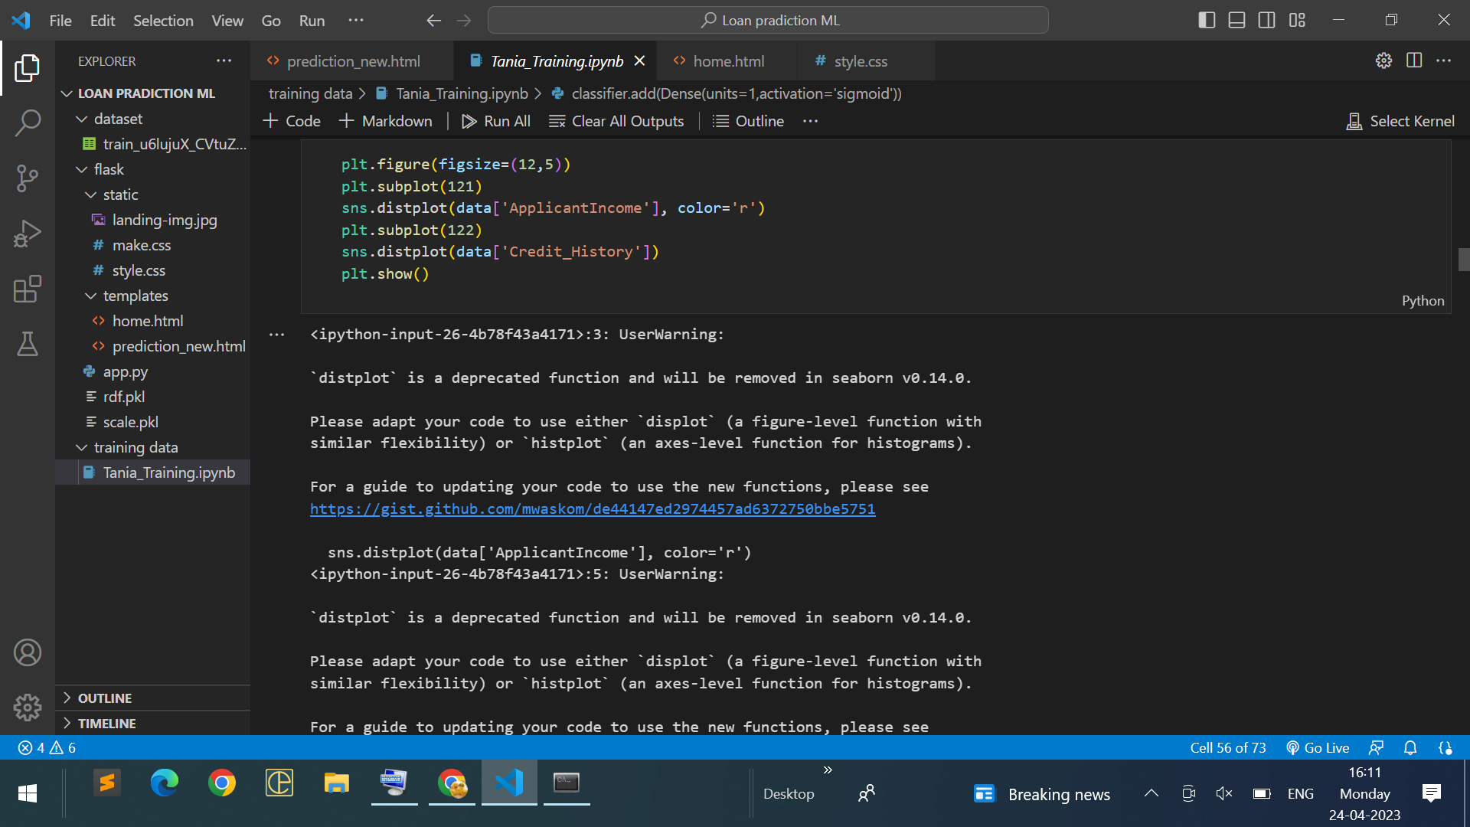
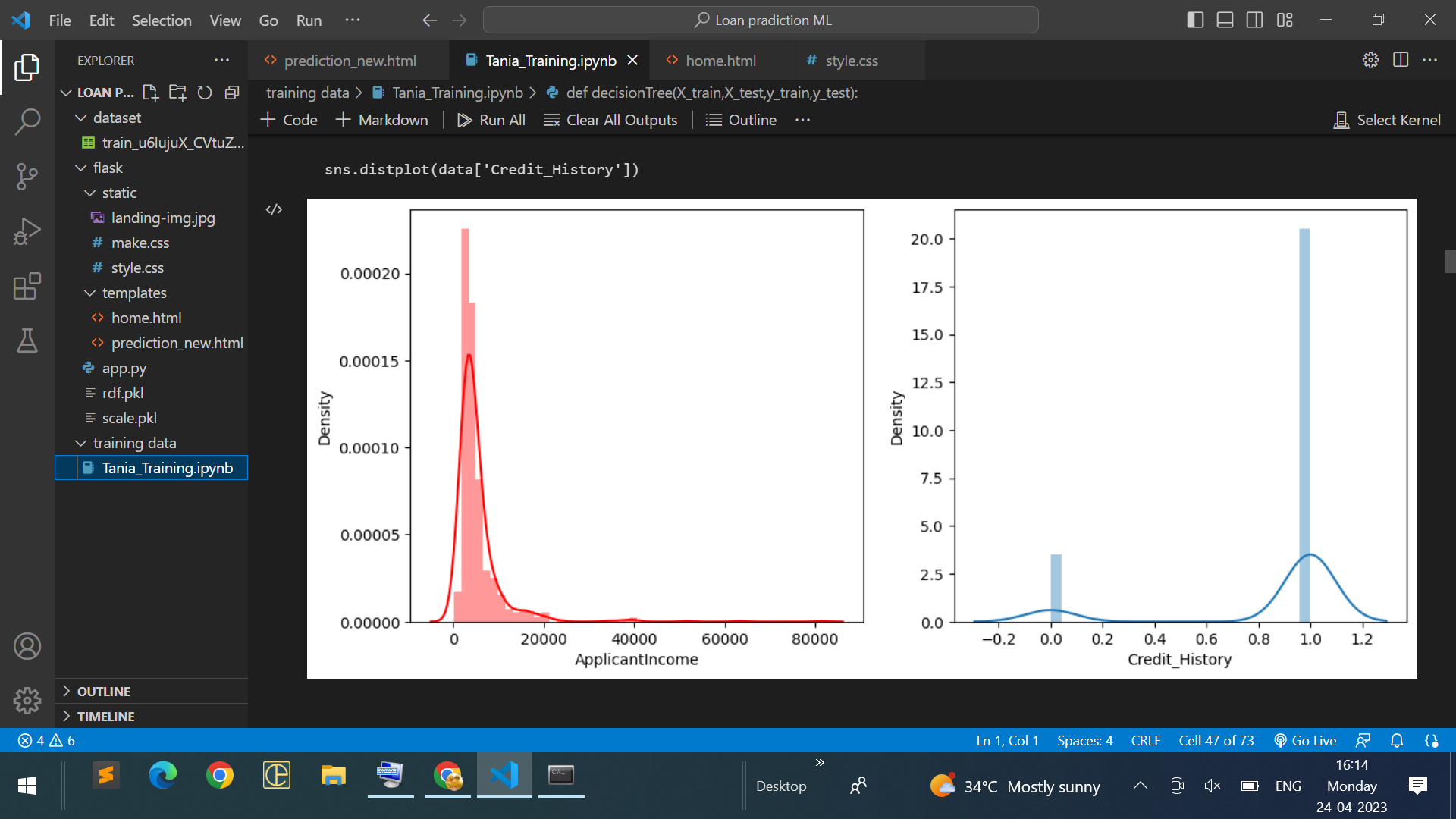
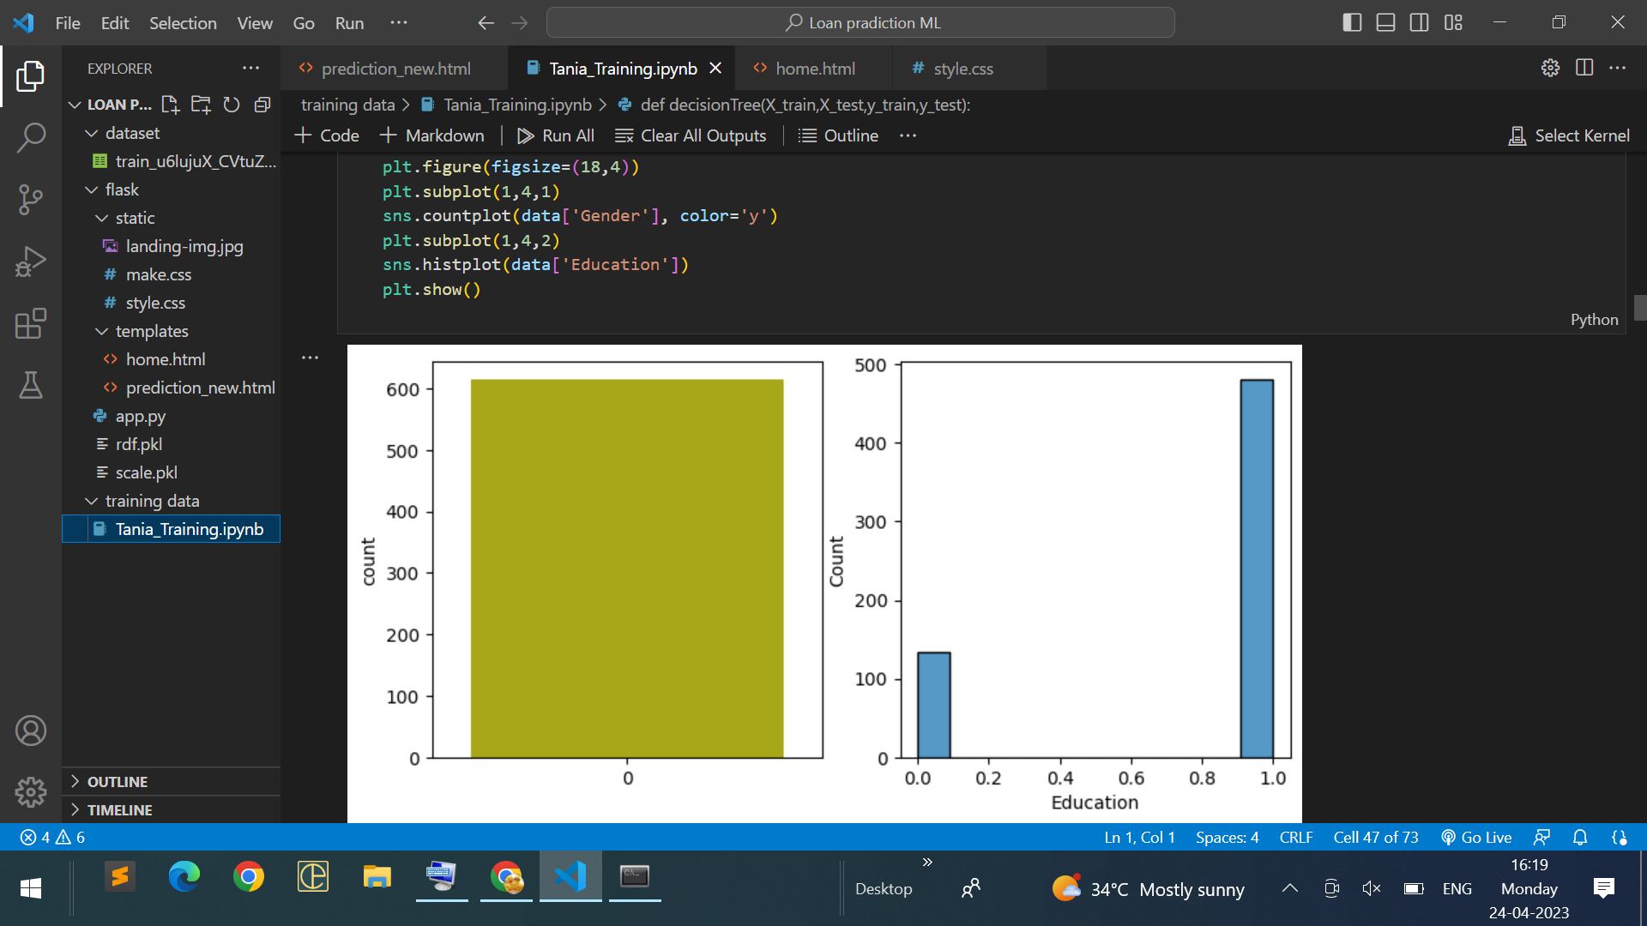
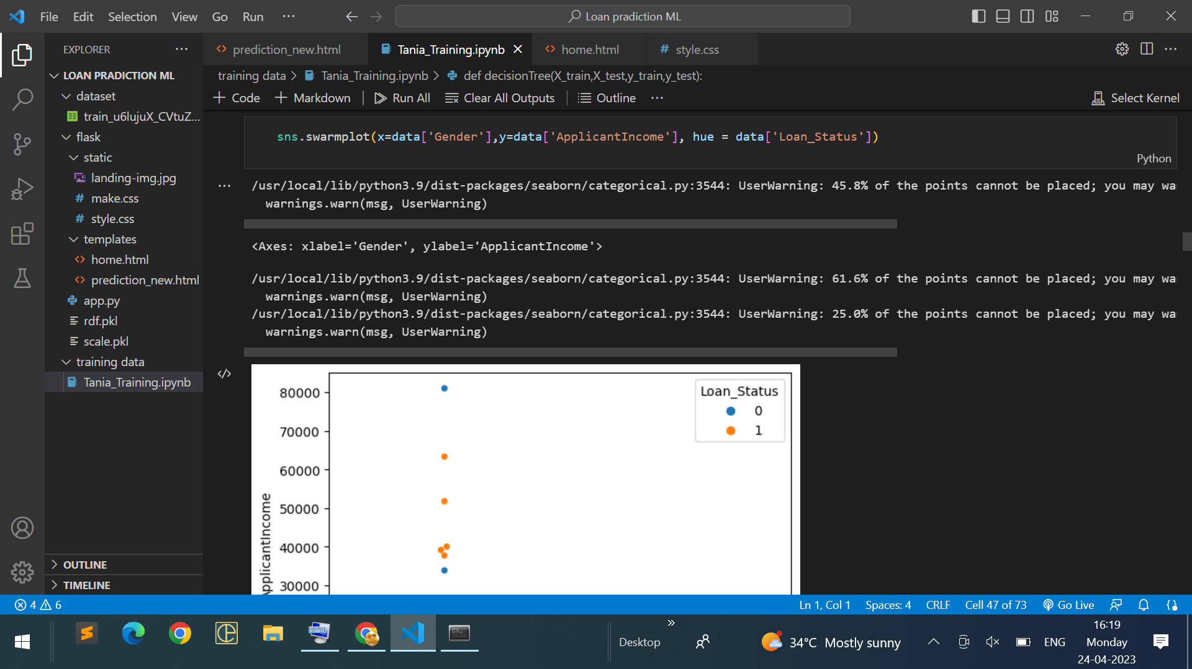
Exploratory Data Analysis
Descriptive Statistical: Descriptive analysis is to study the basic features of data with the statistical process. Here pandas has a worthy function called describe. With this describe function we can understand the unique, top and frequent values of categorical features. And we can find mean, std, min, max and percentile values of continuous features.
Visual Analysis: Visual analysis is the process of using visual representations, such as charts, plots, and graphs, to explore and understand data. It is a way to quickly identify patterns, trends, and outliers in the data, which can help to gain insights and make informed decisions.
Univariate Analysis: In simple words, univariate analysis is understanding the data with a single feature. Here we have displayed two different graphs such as distplot and countplot.
Bivariate analysis: Bivariate analysis is a statistical method that involves the analysis of the relationship between two variables. In other words, it is the study of the relationship between two variables to determine whether there is a correlation between them or not.
Multivariate Analysis: In simple words, multivariate analysis is to find the relation between multiple features. Here we have used a swarm plot from the seaborn package.

Slide 10
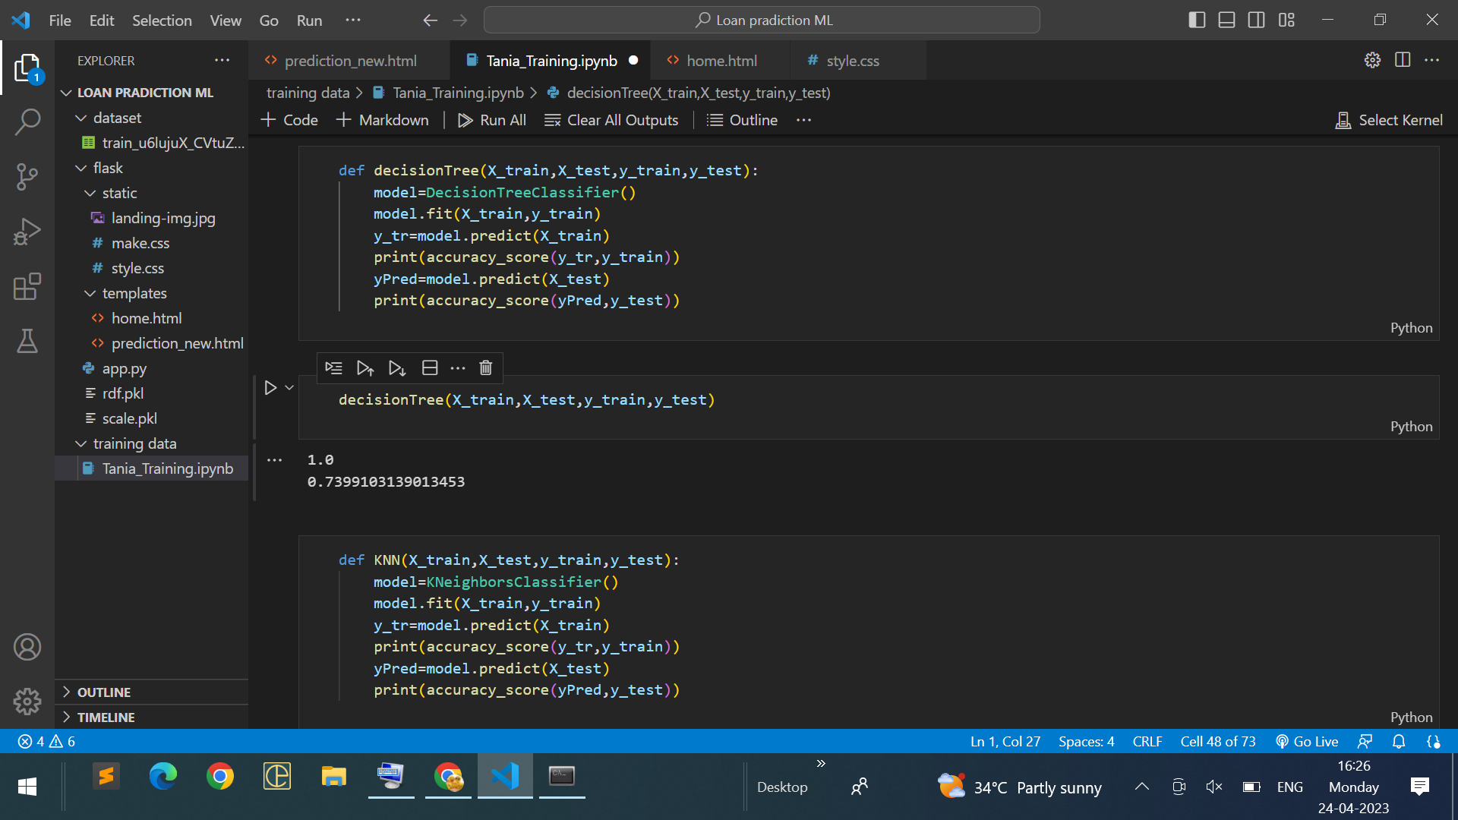
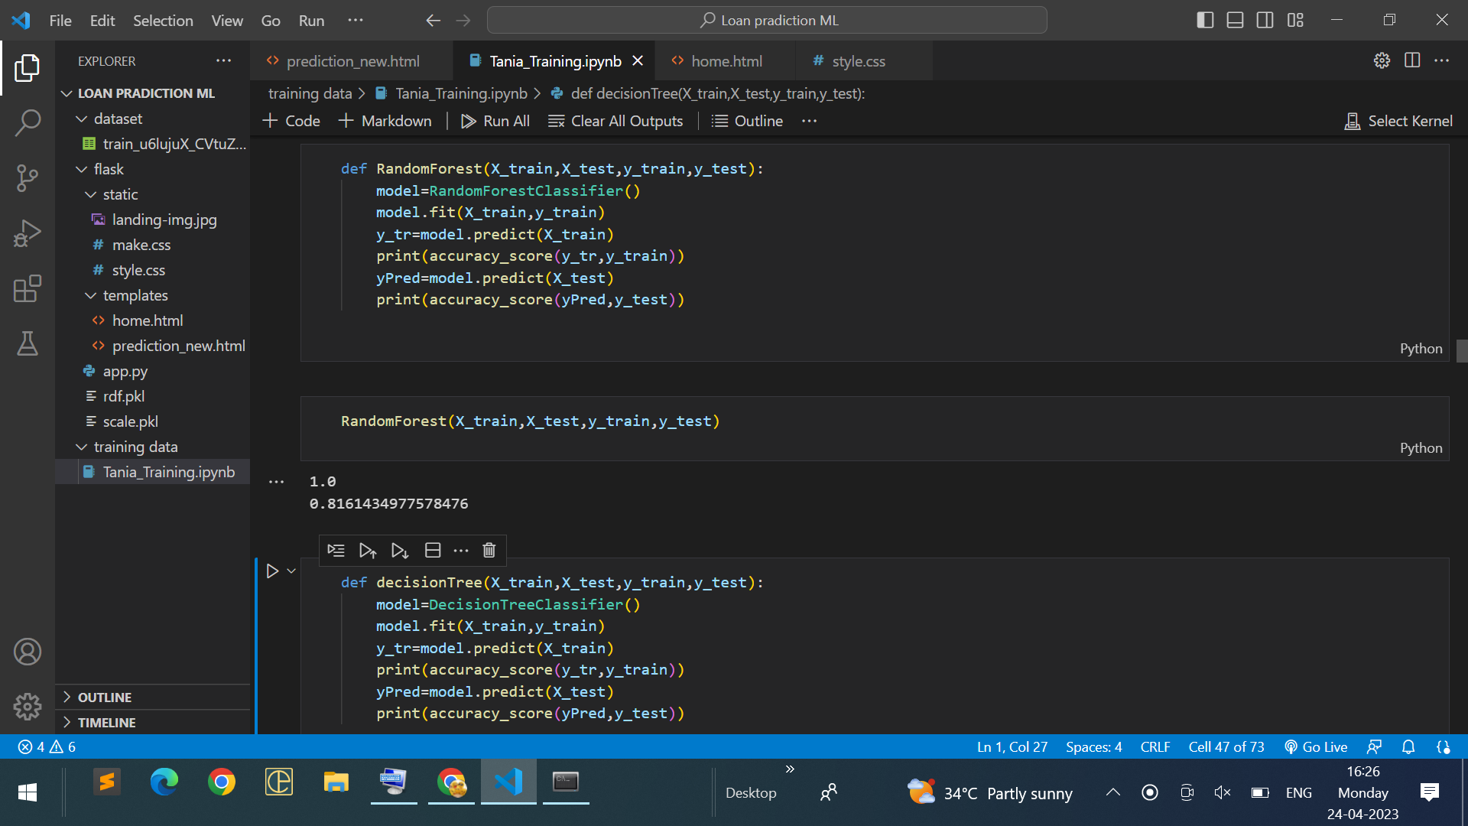
MODEL SELECTION
Decision Tree Model: A function named decisionTree is created and train and test data are passed as the parameters. Inside the function, DecisionTreeClassifier algorithm is initialised and training data is passed to the model with the .fit() function. Test data is predicted with .predict() function and saved in a new variable. For evaluating the model, a confusion matrix and classification report is done.
Random Forest Model: A function named randomForest is created and train and test data are passed as the parameters. Inside the function, RandomForestClassifier algorithm is initialised and training data is passed to the model with .fit() function. Test data is predicted with .predict() function and saved in a new variable. For evaluating the model, a confusion matrix and classification report is done.

Slide 11
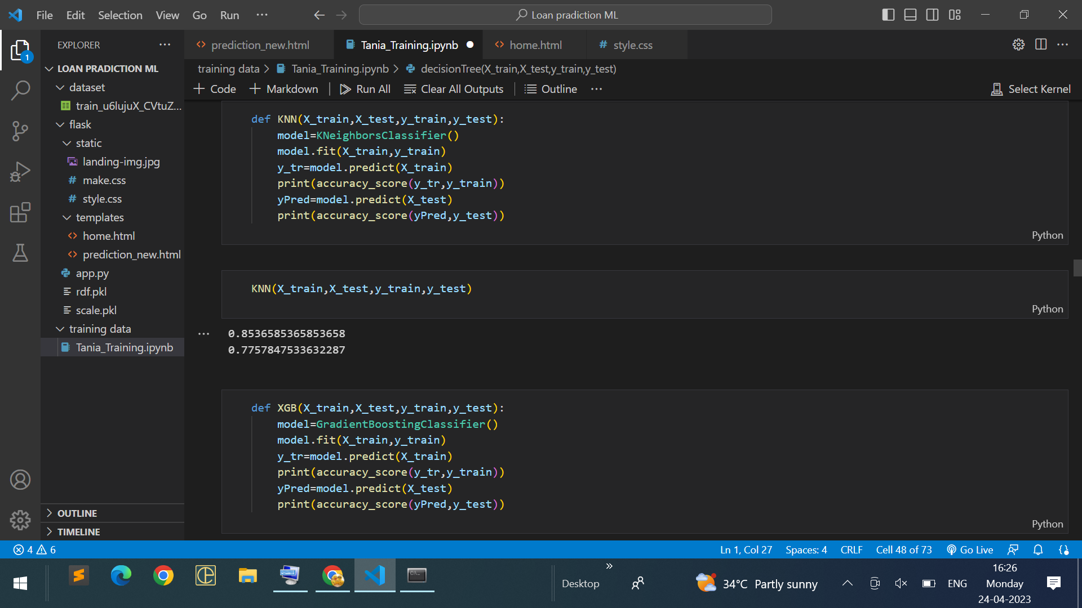
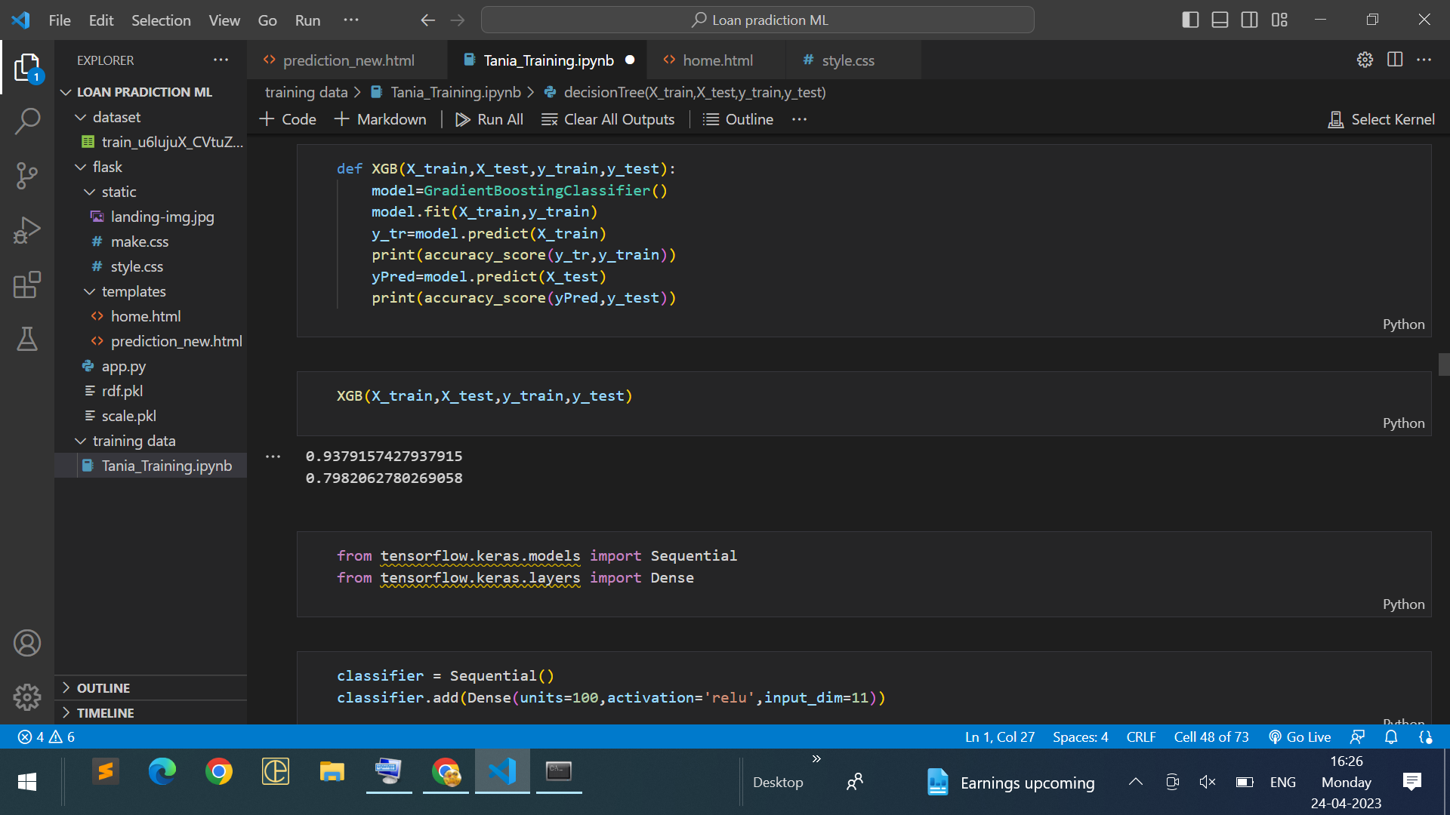
KNN Model: A function named KNN is created and train and test data are passed as the parameters. Inside the function, KNeighborsClassifier algorithm is initialised and training data is passed to the model with .fit() function. Test data is predicted with .predict() function and saved in new variable. For evaluating the model, confusion matrix and classification report is done.
Xgboost Model: A function named xgboost is created and train and test data are passed as the parameters. Inside the function, GradientBoostingClassifier algorithm is initialised and training data is passed to the model with .fit() function. Test data is predicted with .predict() function and saved in new variable. For evaluating the model, confusion matrix and classification report is done.
ANN Model: Building and training an Artificial Neural Network (ANN) using the Keras library with TensorFlow as the backend. The ANN is initialised as an instance of the Sequential class, which is a linear stack of layers. Then, the input layer and two hidden layers are added to the model using the Dense class, where the number of units and activation function are specified

Slide 12
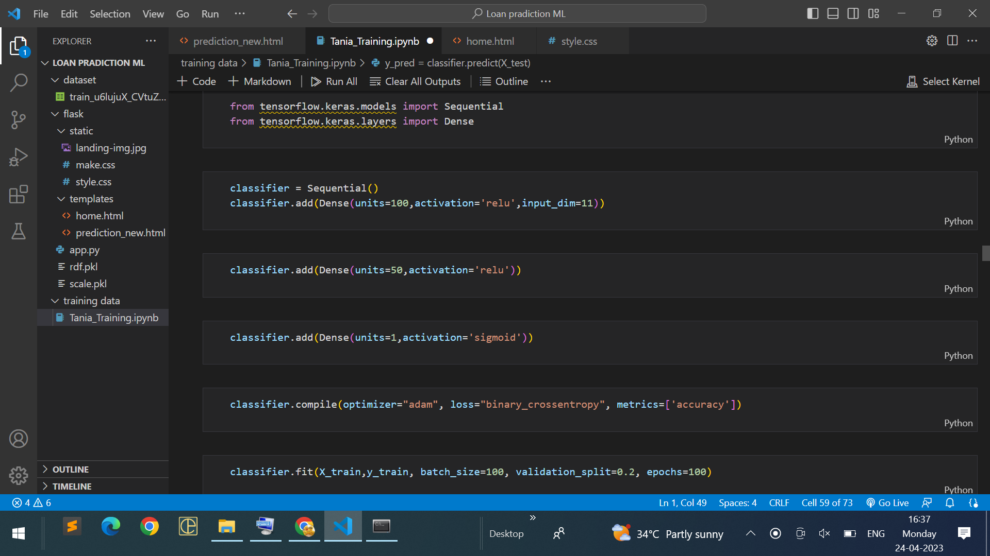
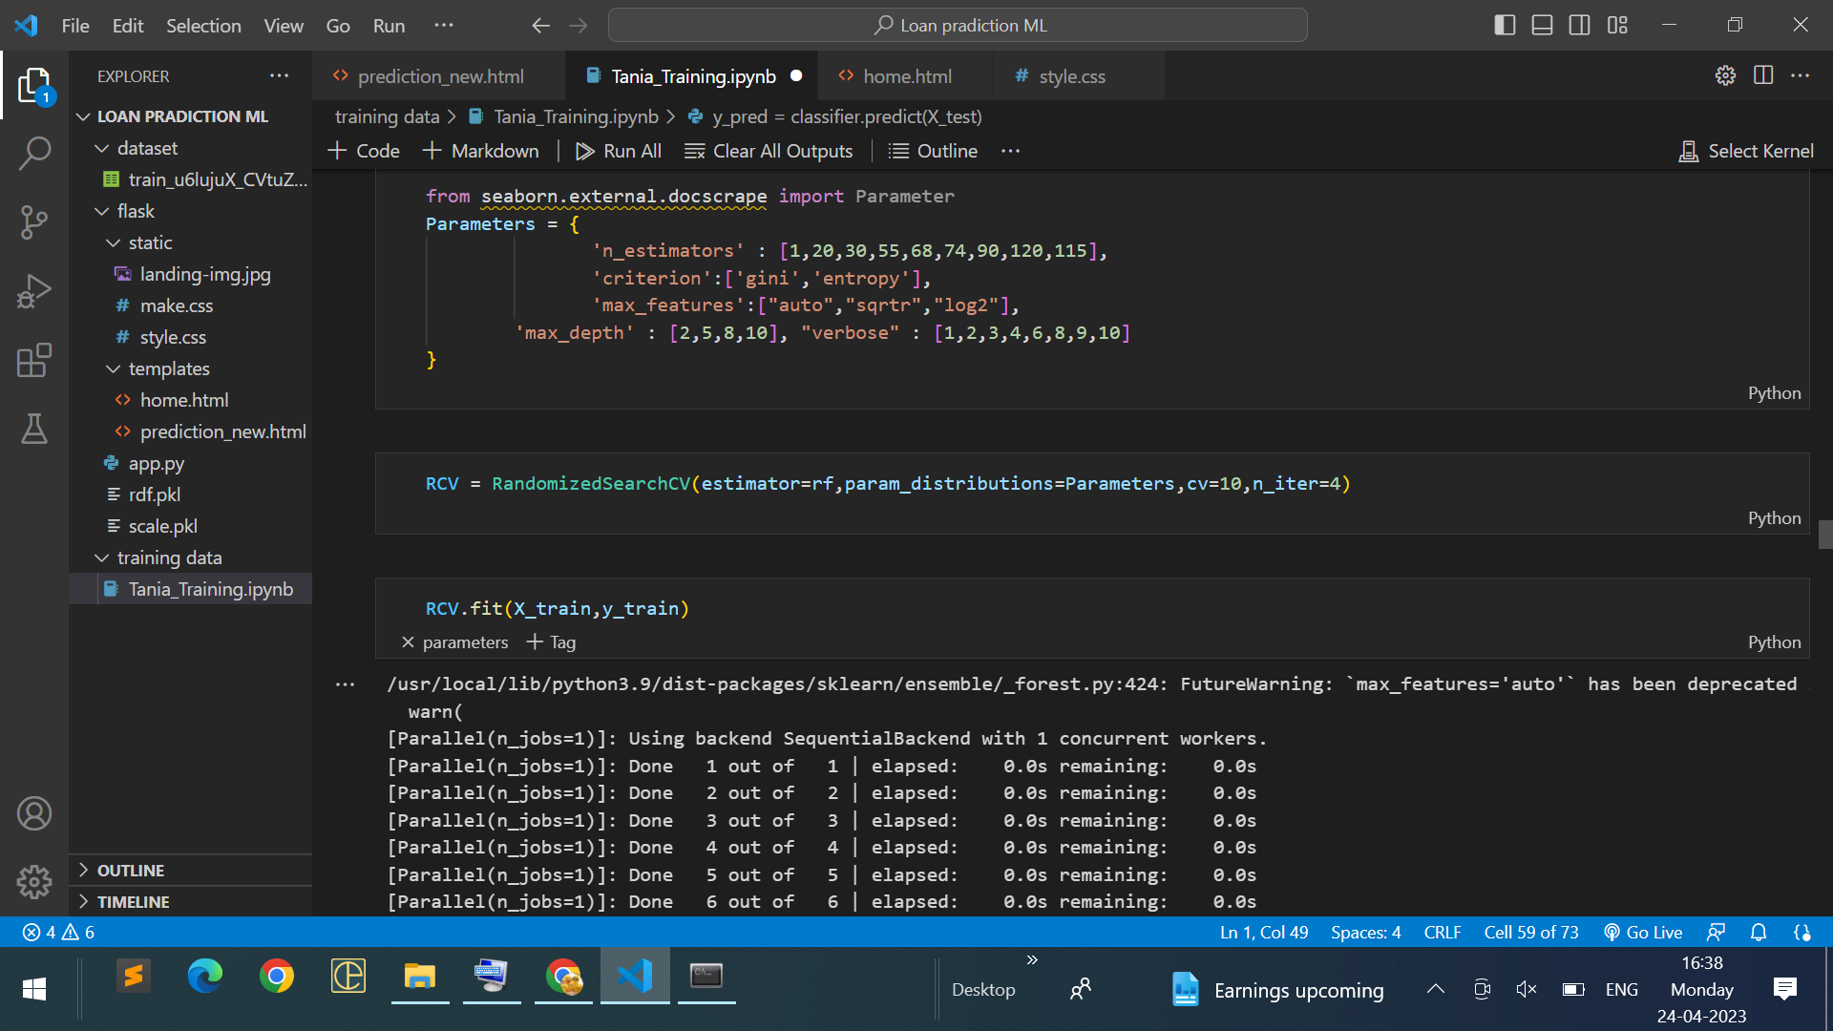
MODEL EVALUATION
Multiple evaluation metrics means evaluating the model's performance on a test set using different performance measures. This can provide a more comprehensive understanding of the model's strengths and weaknesses. We are using evaluation metrics for classification tasks including accuracy, precision, recall, support and F1-score.

Slide 13
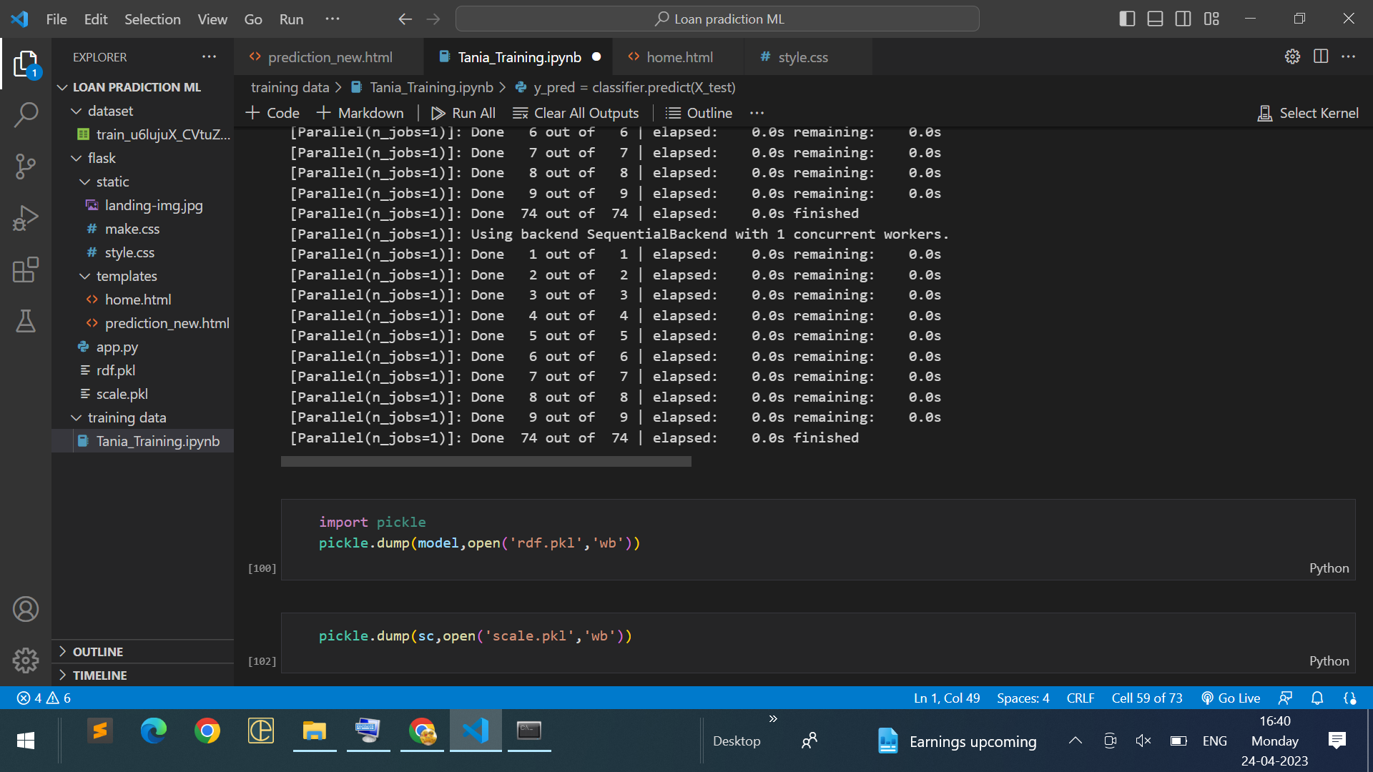
Hyperparameter Tuning
Evaluating performance of the model From sklearn, cross_val_score is used to evaluate the score of the model. On the parameters, we have given rf (model name), x, y, cv (as 5 folds). Our model is performing well. So, we are saving the model by pickle.dump().

Slide 14

SCREEN DESIGN
home.html:

Slide 15
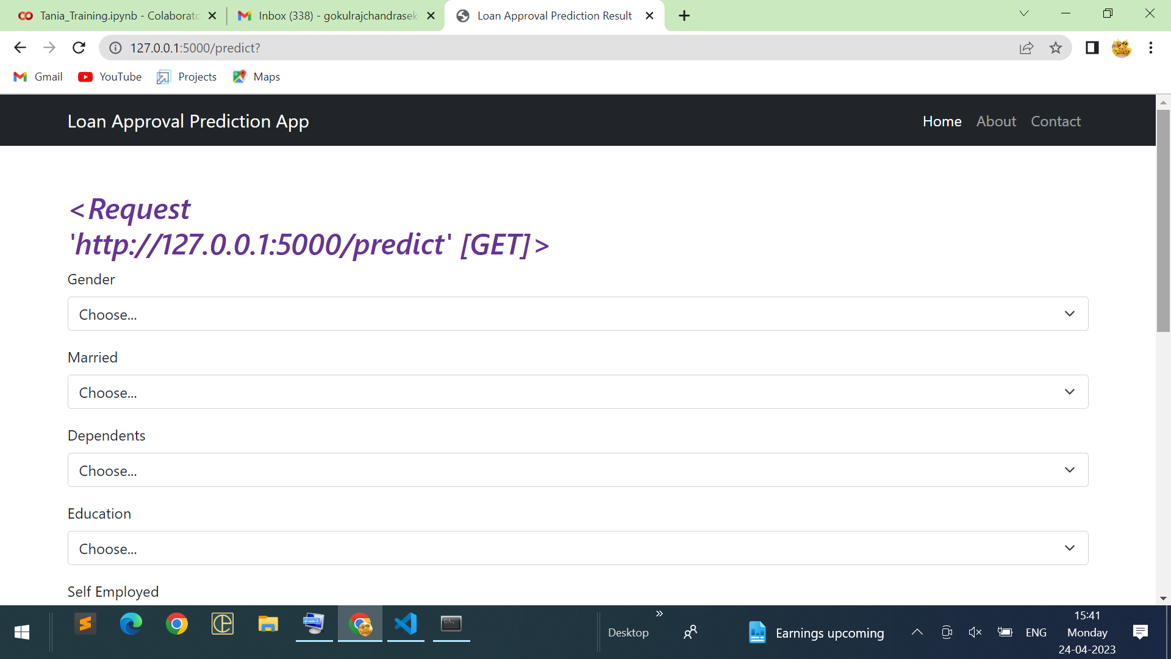
Prediction_new.html:

Slide 16
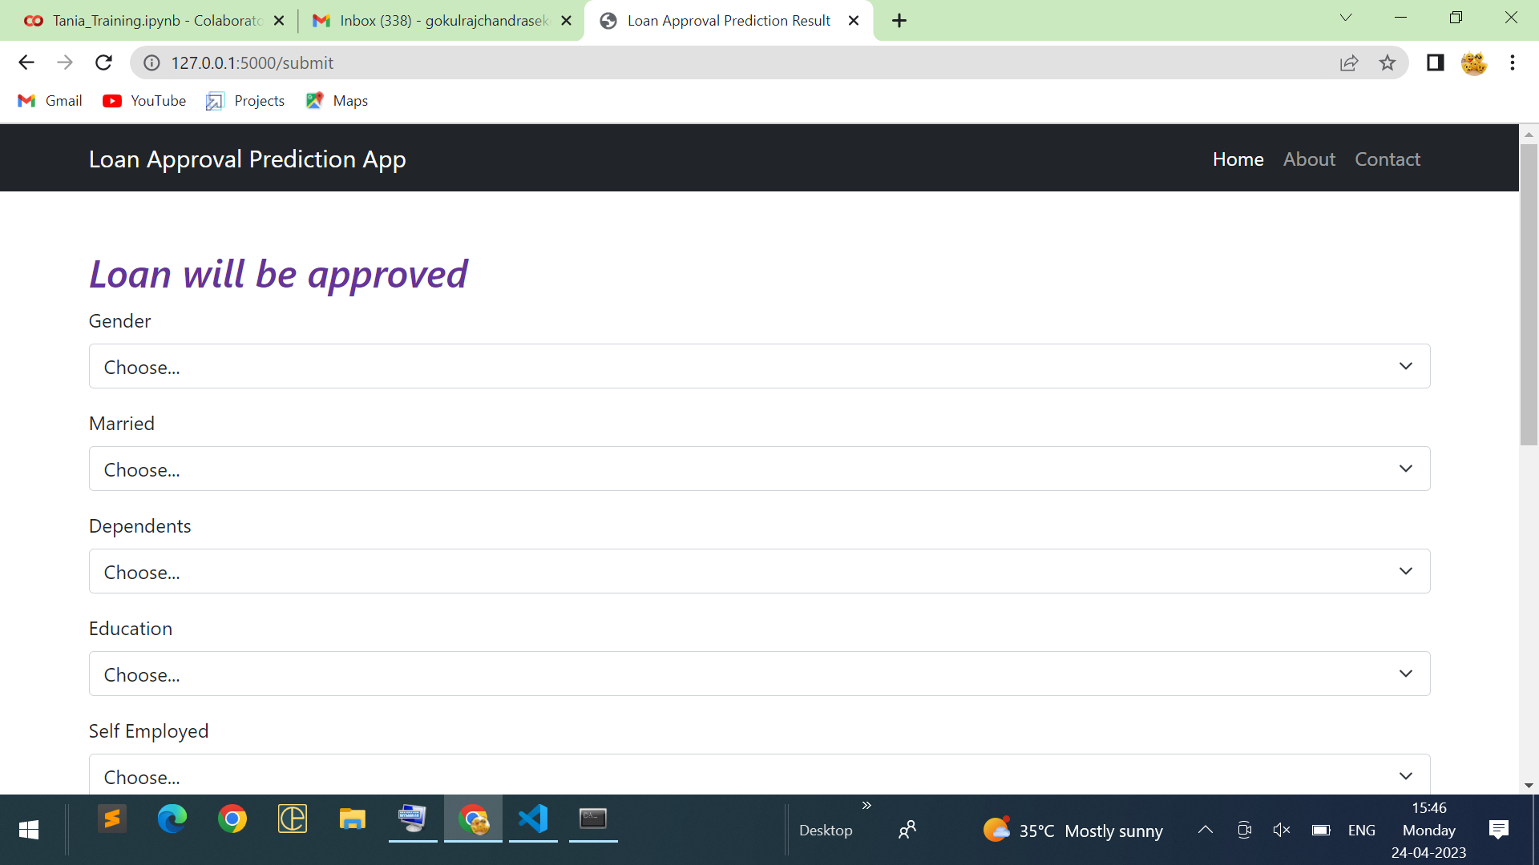
Output Result

Slide 17
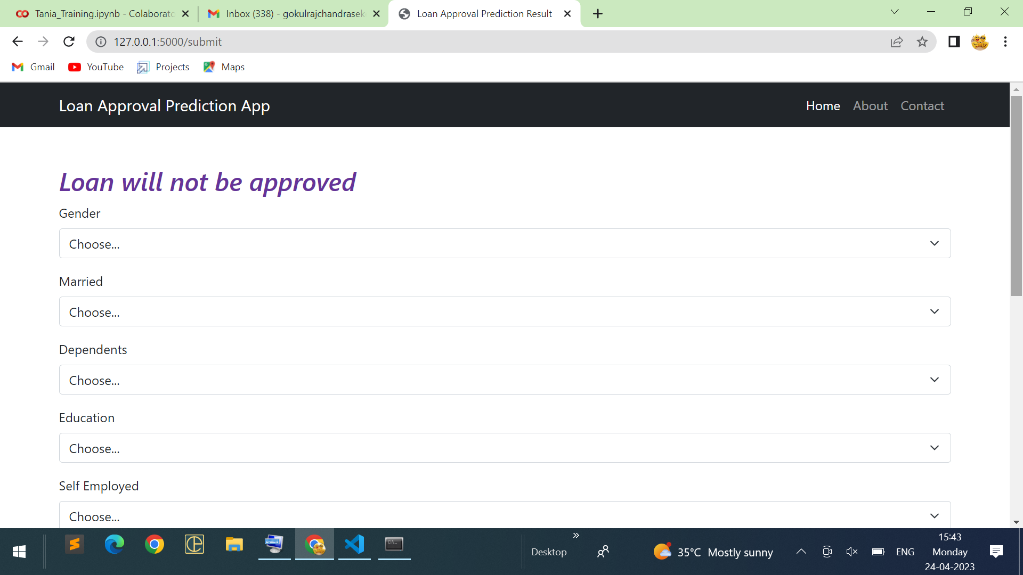

Slide 18



CONCLUSION
In this project, we explored the use of machine learning for predicting personal loan default. We used a dataset of historical loan data and borrower characteristics to train a machine learning model, and evaluated its performance using various metrics.
Our results show that machine learning can be a powerful tool for predicting loan default, with high accuracy rates achieved by the models. By identifying important features such as income, credit score, and loan amount, the model can help lenders to make informed decisions about loan approval and interest rates, while minimizing risk.
However, it is important to note that there are limitations to the use of machine learning in predicting personal loan default. For example, our model was trained on a specific dataset, and may not generalize well to other datasets or populations. Additionally, the model may not account for factors such as changes in economic conditions or unexpected life events that could impact borrower behavior.

Slide 19


